Slide 1
PRODUCTION OF ITACONIC ACID FROM OIL PALM EMPTY FRUIT BUNCH BY ASPERGILLUS TERREUS
Group B4

Slide 2
Group Members
Chin Sze Jie
Renuga A/P Rames
Zahirudin Syafiq Bin Zainudin
Ashwini Navalan
Nurhaida Izzani Binti Ismail
Munshi Ferdous

Slide 3
Agenda
01
Design Objective & Process Description
05
Mass Balance Sheet
02
Process Synthesis (Synthesis Tree Diagram)
06
Technoeconomic Evaluation
Plant Layout, Safety Measures & Environmental Impact
03
07
Process Analysis (BFD)
04
Process Analysis (PFD)
08
Conclusion

Slide 4
01
Design Objective & Process Description

Slide 5
Design objective
To produce 1000 t/year of itaconic acid with 99% purity from oil palm empty fruit bunch by Aspergillus terreus
Process description
First OPEFB is ground to reduce the particle size of OPEFB, next it will go through pretreatment process for further delignification with sodium hydroxide solution.
After that, the solid residues are washed with tap water until it reaches a neutral pH.
Enzymatic hydrolysis will be performed to convert fermentable sugars. Then, it will undergo fermentation.
For downstream processing, it includes centrifugation, evaporation, crystallisation, liquid-solid separation through filtration, also heating and adsorption process.

Slide 6
02
Process Synthesis (Synthesis Tree Diagram)

Slide 7
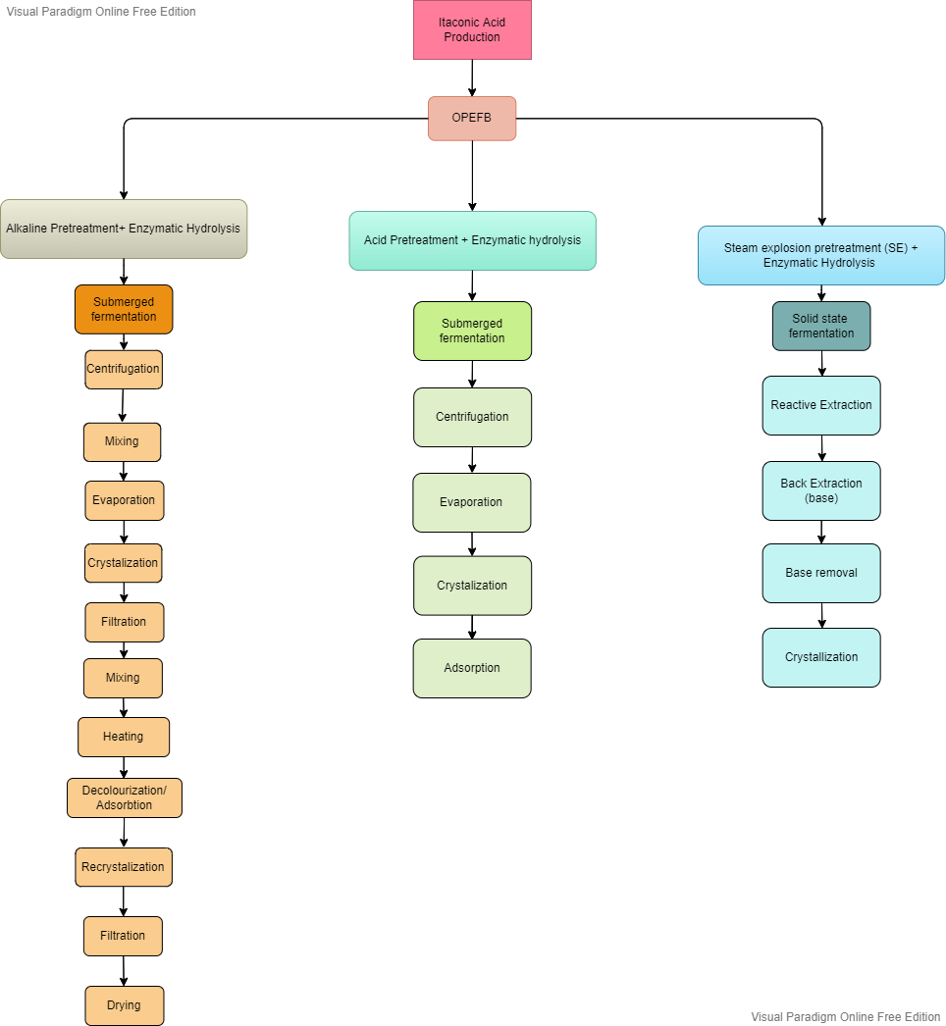

Slide 8
03
Process Analysis (BFD)

Slide 9
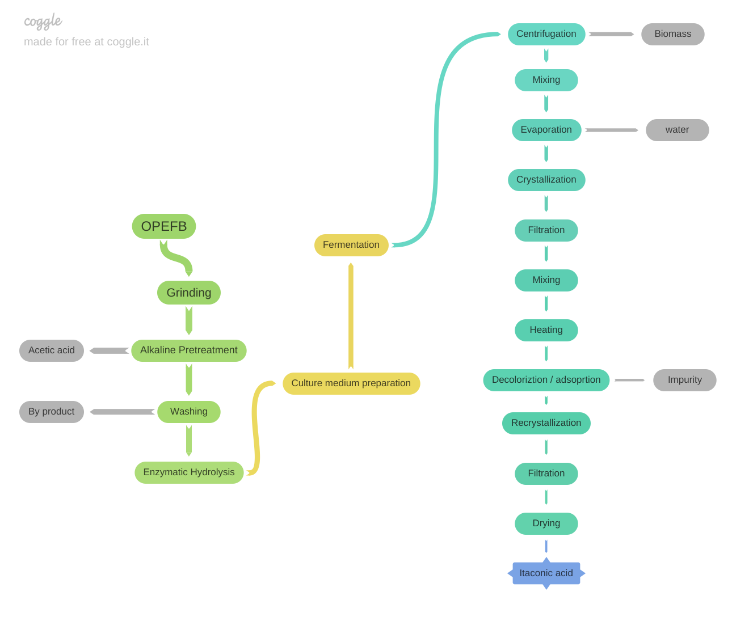

Slide 10
04
Process Analysis (PFD)

Slide 11
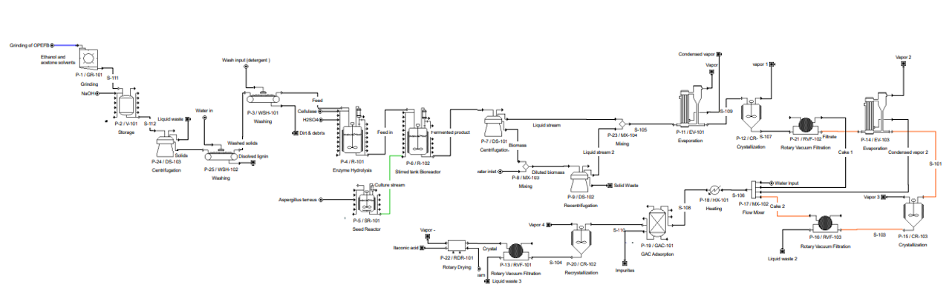

Slide 12
05
Mass Balance Sheet

Slide 13
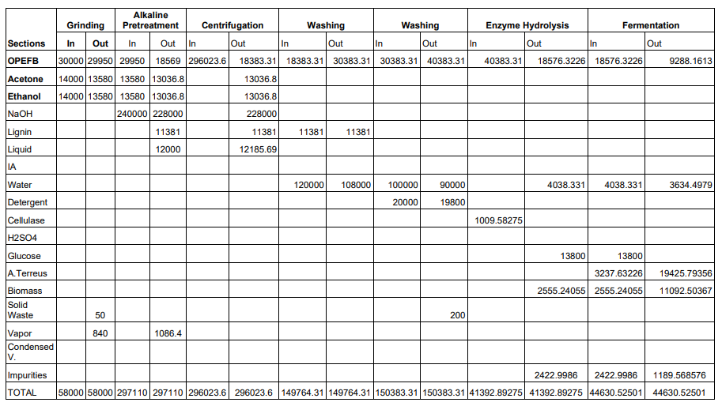

Slide 14
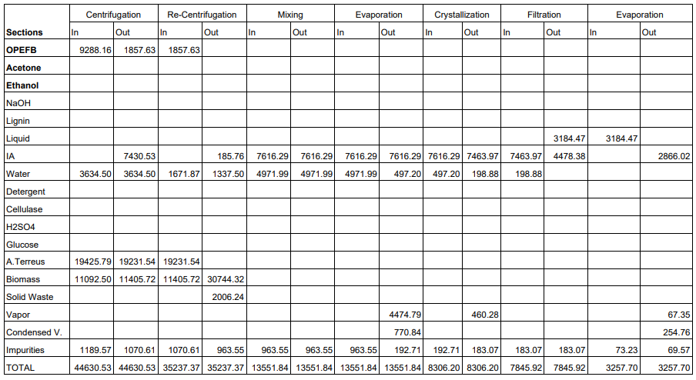

Slide 15
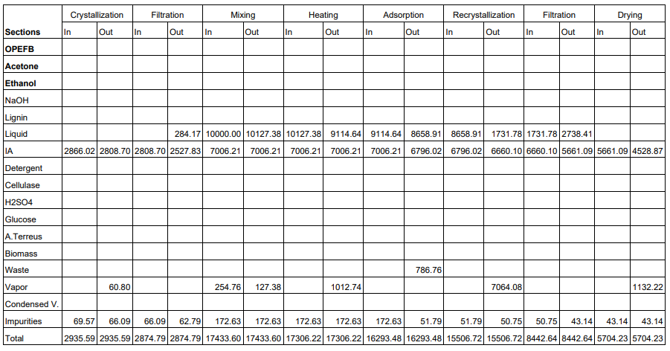

Slide 16
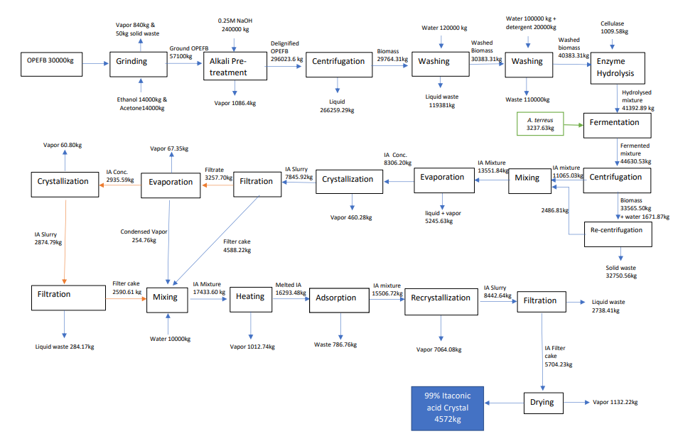

Slide 17
06
Technoeconomic Evaluation

Slide 18
Technical Evaluation
 | Our product | A.B Enterprises | Shanghai CRM New Material Technology Co.,Ltd
Purity (%) | 99 | 98 | 99
Origin | Malaysia | India | China
Form | White crystalline powder | White to light beige crystalline powder | White crystalline powder
Density (g/cm³) | 1.63 | 1.63 | 1.30
Melting point (℃) | 163-169 | 165-168 | 119-121
Boiling point (℃) | 268 | 268 | 214.6
Solubility in water (g/L) | 83 | 83 | 150
Price (RM/kg) | 80 | 25 | 264

Slide 19
CAPEX
Equipment | Capacity | Unit | Unit Cost (RM) | Cost (RM)
Grinder | 60,000 kg/day | 1 | 37,500 | 37,500
Washer | 1,000 kg/h | 2 | 35,000 | 70,000
Stirred tank bioreactor | 45,000 L | 8 | 3,049,000 | 243,920,00
Disk stack centrifuge | 100,000 L/h | 3 | 19,124,000 | 57,372,000
Seed reactor | 850 L | 4 | 3,019,000 | 12,076,000
Evaporator | 500 m² | 2 | 6,501,000 | 13,002,000
Crystalliser | 10,000 L | 3 | 3,295,000 | 9,885,000
Heat exchanger | 90 m² | 1 | 547,000 | 547,000

Slide 20
CAPEX
Equipment | Capacity | Unit | Unit Cost (RM) | Cost (RM)
Rotary dryer | 47.12 m² | 1 | 14,270,000 | 14,270,000
GAC column | 35342.92 L | 1 | 1,960,000 | 1,960,000
Mixer | 360,000 kg/h | 3 | 390,000 | 1,170,000
Rotary vacuum filter | 75 m² | 3 | 1,021,000 | 3,063,000
Storage tank | 58,000 L | 2 | 1,227,000 | 2,454,00
 |  |  | TOTAL | 127,793,000

Slide 21
OPEX
Overall material cost
Bulk Material | Unit Cost (RM) | Per Entry (kg) | Annual Amount | Annual Cost (RM)
Acetone (5%) | 3.7 | 700 | 182,000 | 673,400
Ammonia | 1.2 | 1010 | 262,600 | 315,120
Ethanol (79 g/L) | 3.4 | 1106 | 287,560 | 977,704
Cellulase | 12.34 | 1009.58 | 262,490.80 | 3,239,136.47
Detergent | 1.1 | 20000 | 5,200,000 | 5,720,000
NaOH (0.25M) | 0.84 | 240 | 62,400 | 52,416
Discrete Materials | (RM/Entity) | Per Entry | Entities | Cost (RM)
OPEFB | 88 | 30000 | 330 | 29,040
 |  |  | TOTAL | 11,006,816.47

Slide 22
Electric consumption in production of IA
Equipment | Unit operation required | Power (kW) | Operation hours | Total kW/h | Electric consumption (RM)
Grinder | 1 | 3 | 8 | 28 | 6.21
Washer | 1 | 2.2 | 8 | 17.6 | 3.91
Stirred reactor | 8 | 75 | 24 | 1,800 | 3,196.80
Disk stack centrifuge | 3 | 4 | 4 | 16 | 10.65
Seed reactor | 4 | 3 | 24 | 72 | 63.36
Evaporator | 2 | 2 | 8 | 16 | 7.10
Crystalliser | 3 | 25 | 8 | 200 | 133.20

Slide 23
Electric consumption in production of IA
Heat exchanger | 1 |  | 8
Rotary dryer | 1 | 0.6 | 8 | 4.8 | 1.07
GAC column | 1 | 35 | 8 | 280 | 62.16
Mixer | 3 | 0.75 | 8 | 6 | 4.00
Rotary vacuum filter | 3 | 0.6 | 8 | 4.8 | 3.21
 |  |  |  | Total | RM 3,491.67
*Price of electricity per kilowatt hour = RM0.222

Slide 24
Water consumption for production of 4572 kg itaconic acid
Total water used (m³) | Water consumption (RM)
220 per batch | 440
Price of water per m³ = RM2.00
Management and staff cost
Staff | No. of staff required | Monthly salary (RM) | Total (RM)
Operator (full time) | 10 | 2100 | 21,000
Engineer | 3 | 3000 | 9000
Administrative officers | 5 | 2500 | 12,500
 |  | Total | 42,500

Slide 25
Financial economic assumption
Parameter | Assumption
Plant capacity | 4572 kg/day
Time required to produce 1000 tonnes itaconic acid | 260 days
CAPEX | RM 127,793,000
OPEX | RM 11,053,248.14

Slide 26
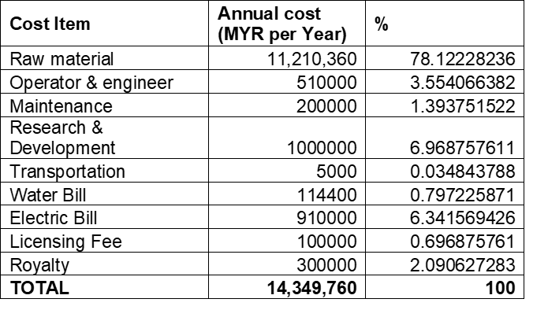
ANNUAL OPERATING COST SUMMARY TABLE

Slide 27
FIXED CAPITAL ESTIMATE SUMMARY
Total Plant Direct Cost (TPDC) |  | Cost (RM)
Equipment Purchase Cost |  | 12779300
Installation |  | 65,979,000
Process Piping |  | 52,750,000
Instrumentation |  | 60,286,000
Insulation |  | 4,521,000
Electrical |  | 15,072,000
Buildings |  | 67,822,000
Yard Improvement |  | 22,607,000
Auxiliary Facilities |  | 60,286,000
 | TPDC | 477,116,000

Slide 28
FIXED CAPITAL ESTIMATE SUMMARY
Total Plant Indirect Cost (TPIC)
Engineering |  | 125,009,000
Construction |  | 175,013,000
 | TPIC | 300,023,000
Total Plant Cost (TPC = TPDC + TPIC)
 | TPC | 777,139,000
Contractor’s Fee & Contingency (CFC)
Contractor’s Fee |  | 40,003,000
Contingency |  | 80,006,000
 | CFC | 120,009,000
Direct Fixed Capital Cost ( DFC = TPC + CFC)
 | DFC | 897,148,000

Slide 29
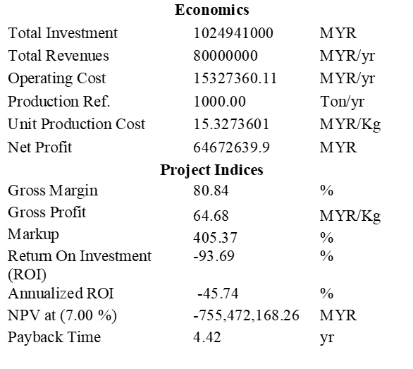
EXECUTIVE SUMMARY

Slide 30
07
Plant Layout, Safety Measures & Environmental Impact

Slide 31
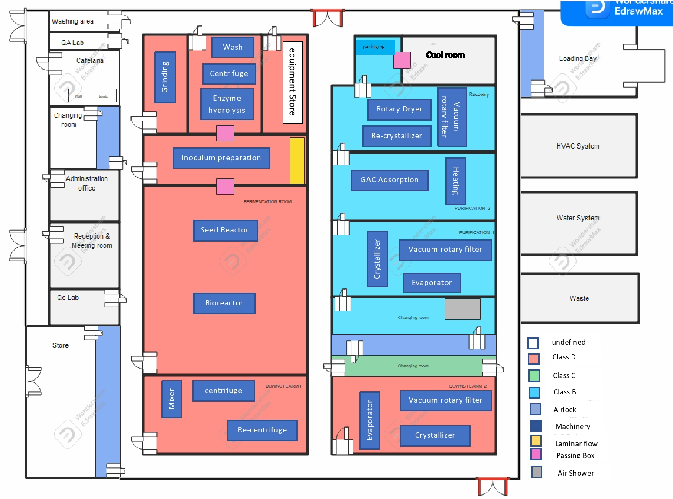

General Plant Layout

Slide 32
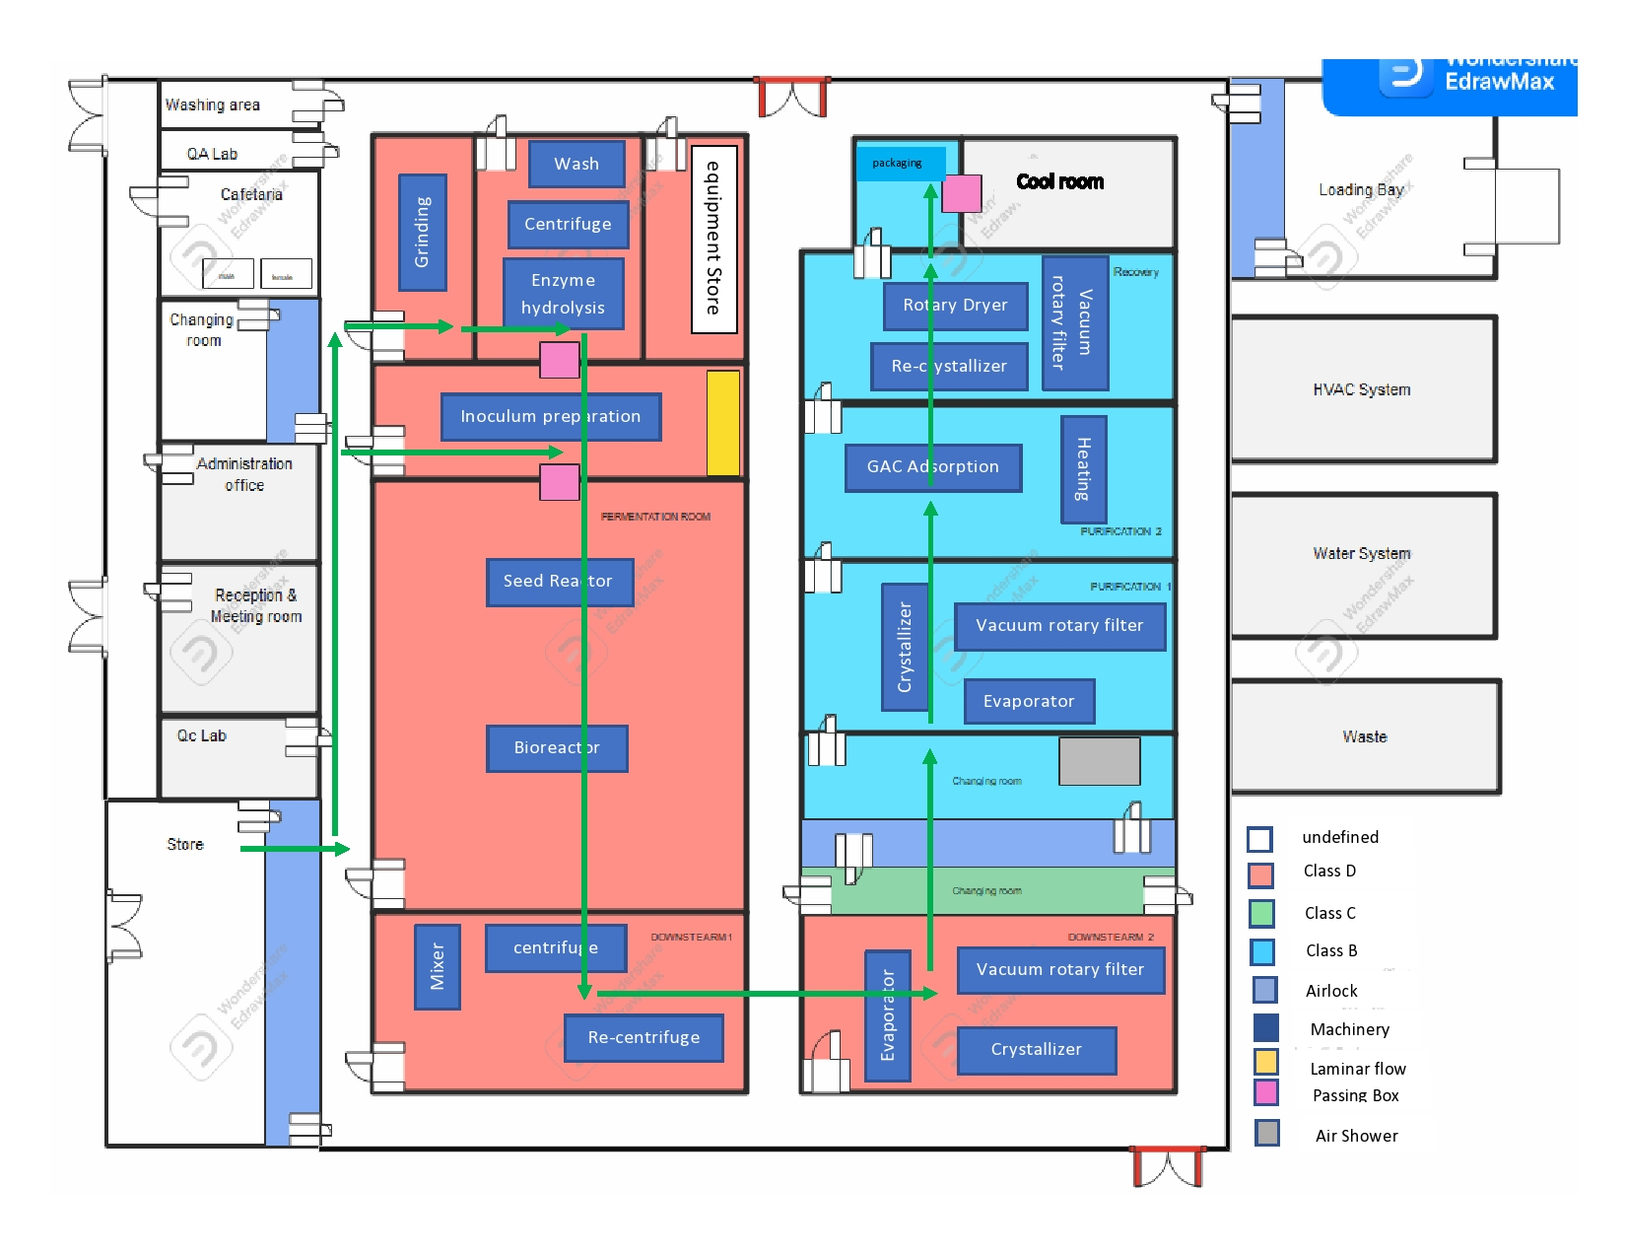
Process Flow

Slide 33

Personnel Flow

Slide 34

Material Flow

Slide 35
General Workplace Safety Measures
Wear personal protective equipment (PPE)
Notify supervisor of any impairment
Only trained workers can operate
Report all accidents to supervisor
Keep all tools in a designated area

Slide 36
First Aid Measures
Swallowed
Eye
Do not induce vomiting
If vomiting, lean patient forward or place on left side to keep airway open
Flush the eye continuously with running water
Keep eyelids apart from eye

Slide 37
First Aid Measures
Skin
Inhaled
Remove all contaminated clothing
Flush skin and hair with running water
Leave contaminated area
Lay patient down, keep warm and rested

Slide 38
Fire Fighting Measures
Extinguishing media: water spray, alcohol-resistant foam, dry chemical, or carbon dioxide
Wear self-contained breathing apparatus and protective gloves for firefighting

Slide 39
Accidental Release Measures
Minor spills
Major spills
Clean up all spills immediately
Use protective equipment
Avoid contact with eyes and skin
Place in a suitable, labelled container for disposal
Alert emergency responders and tell them location and nature of hazard

Slide 40
Safety Measures for Unit Operations
Grinder
Stirred reactor
Disk-stack centrifuge
Stay alert and watch what you are doing
Do not use tool while tired or under the influence of drugs, alcohol or medication
Keep loose clothing, gloves, and long hair away from moving parts
Check the electric system regularly
When the temperature or pressure exceeds the safety limit, use the temperature or pressure relief valve to prevent it from exploding
Operate at above 0℃ as below it will make the liquid freeze and lead to machine damage
Do not repair the worn-out bowl of a disk-stack centrifuge by welding

Slide 41
Safety Measures for Unit Operations
Mixer
Evaporator
Crystalliser
Check the condition of the pressure gauges and other indicators on a regular basis to ensure that the boilers and other metallic devices are free of corrosion and that their rubber gaskets are in good working order
To avoid accidental starting and possible injury, lock the power out
Check carefully because when tools or bolts are left on moving parts, they can fly off
Only qualified service personnel should examine and correct problems that necessitate opening the crystalliser's control panel
Wear gloves and safety glasses while operating

Slide 42
Rotary vacuum filter
Heat exchanger
GAC column
Rotary dryer
Always stop the filter prior to touching it
Never work on the filter when it is hot
Keep the heat exchanger from being over-pressurized
Staying away from hot surfaces
Check the atmosphere inside the vessel
Before entering the vessel, the carbon bed must be completely drained
The storage place shall be dry and well ventilated indoor rooms
The fan must be checked to ensure that it runs in clockwise rotation

Slide 43
Environmental Impact
Global warming
Eutrophication
Increase of greenhouse gas
Inoculum, fermentation: 40%
Pretreatment: 35%
Electricity demand in inoculum and fermentation section: 86%
85% for CO₂, 9% for N₂O, and 5% for CH₄
Inoculum, fermentation: 55%
Recovery section: 22%
Caused by phosphate in water: 98%

Slide 44
08
Conclusion

Slide 45
The design and manufacturing plant for the production of itaconic acid (IA) from oil palm empty fruit bunches by Aspergillus terreus were shown, demonstrating the significance of predicting a large-scale bioprocess focused at increasing the overall productivity of Itaconic Acid.. Itaconic acid will be produced at the plant at a rate of 4572 kg per day with a cost of RM80 per kg, or around 1,188,720 kg per year. Estimates for the required CAPEX and OPEX total RM 127,793,000 and RM 11,053,248.14, respectively.

Slide 46
POP QUIZ!
What is the microbe used in our production of itaconic acid?
Aspergillus terreus
C. Aspergillus niger
B. Bacillus subtilis
D. Staphylococcus aureus

Slide 47
POP QUIZ!
What is the microbe used in our production of itaconic acid?
Aspergillus terreus
C. Aspergillus niger
B. Bacillus subtilis
D. Staphylococcus aureus

Slide 48
Thank you

